Slide 1


BTEC Travel and Tourism Tech Award Revision Booklet
Component 2- External Exam
Factors that influence global travel and tourism
Impact of travel and tourism and sustainability
Destination management
Key words:
Identify= Name or characterise a feature
Describe= Outline Characteristics
Explain= Set out purposes or reasons for, say why
Compare= Identify similarities and differences
Assess= Make an informed judgement
Evaluate= Judge from available evidence

Slide 2
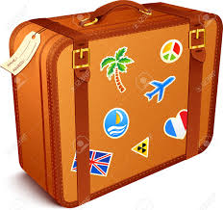




Key words
Concierge
A member of staff, usually in a hotel who helps guests.
Ground Transport
Moves visitors and travellers when they are not flying between destinations e.g. a transfer from the airport to a hotel.
Gateway
Where visitors enter or exit the UK and continue their journey e.g. London Heathrow
Travellers often change from one mode of transport to another at a gateway.
Package Holidays
where the price of a holiday includes transport (air, rail or coach) to get you to your chosen destination and accommodation (hotel).
Terminal
A location where transport journeys start or end e.g. Liverpool Lime Street Station.
PPP
Public-Private Partnership
Self-catering
Where kitchen and cooking facilities are provided for customers to buy and prepare their own meals.
Disposable Income
The money a person has left over to use as they wish, from their wages, after they have paid all of their bills etc.
TALC
Tourism Area Life Cycle Model
DMO
Destination Management Organisation

Slide 3
Learning Aim A
Factors that influence global travel and tourism

Slide 4



Travel and Tourism Organisations
Retail Travel Agents
Offer products and services to customers looking for holidays.
They are found on the main high street in a town or city or in supermarkets.
They can be accessed via telephone through call centres or as web based agents online.
Travel Agents have specific roles including:
Booking flights
Booking package holidays
Arranging trips and excursions
Booking car hire and travel insurance
Providing foreign exchange
Business Travel Agents
Provide the same service as Retail Travel Agents but for the business market.
This might involve booking for employees to attend meetings, conferences and events. They manage all of the travel booking services for a large business, including flights, rail bookings. Hotels, transfers, meeting venues and spaces. They may also arrange chauffeur driven cars and airport parking.
Tour Operators work with different organisations such as hotels and ground transport. They contract large numbers of hotel rooms and flights at discount prices and sell them to customers through travel agents.
E.g. TUI, Jet2holidays, Virgin Holidays.
Accommodation
Tourists need somewhere to stay, whether taking a trip for leisure or business, to visit a conference or event. Each accommodation type offers different options, services and facilities.
Hotels
Hostels
B&B’s
Self-catering apartment
Caravan/campsite
Hotel Facilities and services
Restaurants and bars
Conference and meeting rooms
Concierge service
Business centre
24-hour reception
Fitness and leisure facilities
Parking
Entertainment
Conference and Events Management Companies
These organisations book, or provide venues and locations for conferences and different types of events. They can also arrange equipment hire, audio-visual facilities and catering options.

Slide 5
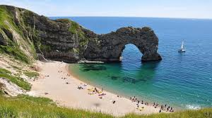
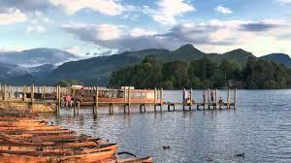
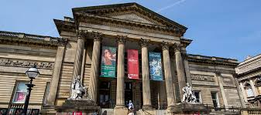
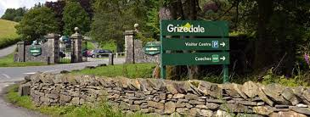

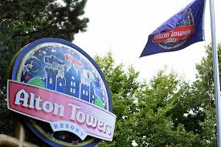
Tourist Attractions
Fun
Entertainment
Spend time with family and friends
Educational facilities
Wheelchair hire
Cafes and shops
Much busier during school holidays and summer months
Provides seasonal work for local people
Built Attractions
Not natural, built by man.
Most tourists visit these to have fun and be entertained.
Most have been purpose built e.g. theme park
Others built for different reasons but now attract visitors such as stately homes and castles.
Art galleries
Museums
Zoo’s
Natural Attractions
These are natural features of the landscape and environment.
Not been built by man.
Many tourists visit these to relax, get exercise, escape from the city and to connect with nature.
Beaches
Caves
Forests
Lakes
Mountains
Free to visit
May need to pay for car parking

Slide 6
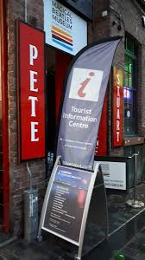

Tourism Promotion
Different organisations promote tourism to raise awareness and to encourage people to travel and visit different destinations. They can also support visitors, providing guidance and advice.
Provide information and advice to visitors
Encourage people to stay and spend money in local attractions, accommodation providers, cafes, bars and restaurants.
Staff are well trained and give advice on…
Where to stay, visit and eat
Opening times of attractions
Driving routes, directions and parking information
Weather advice
Location of key facilities e.g. toilets, cash machines and transport hubs
Tourist or Visitor Information Centres | Regional Tourism Agencies | National Tourism Agencies
Located in many towns and cities They provide support and advice to visitors. The provide services such as directions, hotel bookings, tickets for shows, tours and events. Sell products and merchandise such as gifts, maps and guides. | Located in certain areas. Their aim is to attract more visitors to a specific region, county or area. Manage websites and online promotional campaigns to attract tourists to their area. e.g. Cumbria Tourism | Have a key role in promoting tourism for the whole country. Manage different campaigns and promotions to attract more inbound visitors. Help to raise awareness and the profile of a country and to increase the money earned from tourism. e.g. VisitBritain

Slide 7
Transport
Transport Providers
Airlines
Car hire
Train operators
Ferry companies
Coach and bus operators
Taxi companies
Air Travel | Rail Travel | Sea Travel | Road Travel
Good for travelling longer distances Full-service airlines such as Emirates or Virgin Atlantic offer a range of services included in the ticket price A choice of food and drink options Entertainment such as movies and music Duty-free shopping, eye-masks, travel socks and ear plugs. Different classes of travel- economy, premium, business and first. Low-cost airlines (Ryanair and EasyJet) offer low priced flights with less services and products included. Check-in luggage, seat choice and food and drink available but at an extra cost. | 33 train operating companies in Britain Offer customers a choice of first or standard class travel and the opportunity to buy discount tickets if booked in advance. Examples of large rail terminals Manchester Piccadilly Liverpool Lime Street London Euston | Ferry terminals and ports offer sea travel options for customers. Some ferry services only carry people but others transport vehicles as well as passengers. e.g. Stena Line, Irish Ferries. Range of facilities on board such as bars, restaurants, cabins for longer journeys. Seaport Gateway = Port of Dover, where many visitors from Europe enter the UK. | Own car Hire car Taxi Coach Most convenient and flexible way to travel Network of motorway service stations provides road travellers with facilities such as toilets, fuel, shops and restaurants.
Tourists need safe transport from one destination to another as well as access to a range of facilities and services to make their journeys more comfortable

Slide 8



Regulators
Help to protect customers and ensure that organisations meet industry standards.
Maritime and Coastguard Agency (MCA)
Provides legislation and guidance on maritime (sea) matters.
Responsible for inspections including;
Safety of passengers and crew on boats
Making sure all equipment is fit for purpose on boats
Civil Aviation Authority (CAA)
Helps to ensure that the aviation (airline) industry meets strict and safety standards and ensure that customers are protected.
Runs and manages the Air Travel Organiser’s Licence (ATOL) holiday protection scheme which gives customers a full refund if the company they book their holiday with closes down.
Roles and Responsibilities
Ensure that organisations meet standards
Give customers help and support
Represent members
Help with repatriation (bringing people home if something goes wrong abroad)
Licensing
Dealing with customer complaints
Office of Rail and Road (ORR)
Regulates railways and roads
Provides advice and guidance to passengers on station and platform safety
Monitors serious railway incidents
Monitor Highways England who operate, maintain and improve England’s motorways.
ABTA
Represent travel agents and tour operators
Customers who book with ABTA registered travel agents are protected under its financial protection scheme which would give them a full refund if the travel agency closed.

Slide 9




Ownership of travel and tourism organisations
Voluntary sector
These are independent organisations usually funded by membership donations, grants and the sale of products and services such as tickets, food, drink and merchandise.
e.g.
The National Trust who own and conserve historic houses, monuments, castles, coastlines, forests, gardens, parks and nature reserves.
Over 5 million people are members.
Private Sector
Organisations in this sector are owned or controlled by private individuals, shareholders or companies.
e.g.
Blackpool Pleasure Beach
FlyBe
Alpha Holidays Limited
Public Sector
Organisations in this sector are funded and sometimes owned by central and local governments
e.g.
Tropical World Leeds is owned and managed by Leeds City Council
Aims of travel and tourism organisations
Strategic Aims
Expanding- grow and develop by offering more products and services to more customers.
Competing with other businesses so need to provide consistent excellent customer service, gain good quality customer reviews, have a unique product to sell.
Value for money- offer discounted rates on tickets
Financial Aims
Sell goods and services to make a profit
Increase sales by attracting new customers
Control costs

Slide 10

How travel and tourism organisations work together
Vertical Integration
Where an organisation owns different companies at different levels of the supply chain
e.g. a tour operator might own its own travel agency, airline or hotel
Horizontal Integration
Where a business takes control of another business at the same level
e.g. a travel agent taking over another travel agent-
TUI took over Thomson Travel
Partnerships
Instead of taking over another business, organisations might choose to work together in partnership.
Partnerships can exist between public, private and voluntary organisations
e.g. Virgin Trains work in partnership with Uber the online taxi booking service to provide customers with a smooth journey from door to door.
Why work together?
Provide good customer care
Increase sales and income
Carry out joint marketing and promotion
Cut costs

Slide 11
Types of Tourism
Domestic Tourism
When visitors and tourists take holidays within their own country.
Outbound Tourism
When visitors and tourists travel to a different country from their own country for a holiday.
Inbound Tourism
When visitors and tourists from overseas travel into a different county
Types of destination
Types of Visitor
Coastal areas
Seaside resorts
Sandy beaches
Steep cliffs
Very attractive destinations for many visitors who want to relax, walk, surf, fresh air and fun.
Countryside areas
National parks
Lakes
Forests
Mountains
Individuals
Couples
Families
Groups
Domestic visitors
Inbound visitors
Customers with specific needs
Towns and Cities
Capital cities
Historically and culturally rich
Shopping
Eating out
Entertainment- theatres, shows, concerts
Sightseeing opportunities
Reasons for Travel
Day trips
Holidays
Visiting friends and relatives
Meetings
Conferences
Events
Short breaks
Leisure Travel
When travelling for leisure people are often taking a holiday, or day trip, or travelling to visit a friend or relative.
Business Travel
Travelling to a location or venue for work purposes, for example a meeting, conference or training event.

Slide 12
Types of Holiday
Fly-drive
Involves air travel to a new destination, followed by car hire to allow visitors to explore further afield for themselves.
Self-drive
Include car or motorhome hire and pre-booked accommodation for visitors following a specific route or tour.
Package
All-inclusive
Independent tailor-made
Multicentre
Fly or self-drive
Short breaks
Touring holidays
Specialist/niche
Voluntary work
Holiday parks
short breaks
A trip between one and three nights.
City breaks, spa breaks and activity breaks.
Independent and tailor-made holidays
A selection of different travel services chosen and booked independently, often using the internet and online booking sites so customers can build the holiday experience that they want.
Touring holidays
Offer travellers the chance to see different places in one trip, fully organised by a travel company.
Such as ocean or river cruises and rail or coach tours.
Holiday parks
Holidays that provide families with a range of indoor and outdoor entertainment and accommodation, including live shows, swimming pools, rides and competitions.
e.g. Butlins, Haven etc.
Multicentre
Where travellers visit two or more destinations or resorts as part of one trip.
Package holiday
Where different services are put together by the travel company and offered to customers at a single price.
Specialist and niche holidays
For travellers looking for something a bit different such as attending a major sporting event, experiencing different cultures or taking time out to focus on health and wellbeing.
All-inclusive holidays
These are package holidays but also include all food, selected drinks and activities for one set price.
Voluntary work
Often popular with young travellers who want to gain experience or those with more time to spare to improve the lives of others. E.g. construction projects, teaching English, animal care, sports coaching.

Slide 13
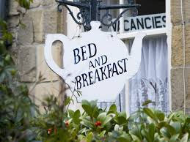
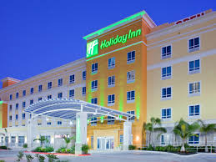
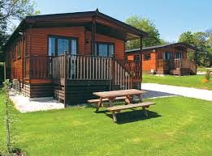
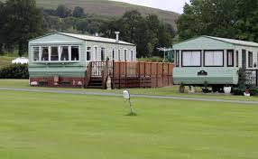
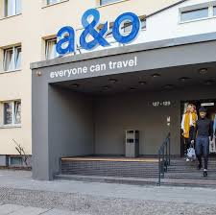
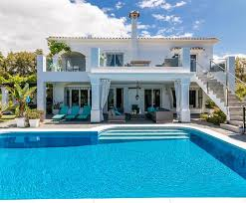
Types of Accommodation
Non-serviced accommodation
Provides less services to visitors and is often cheaper but visitors need to cook and clean for themselves for the duration of their stay. Often includes apartments, villas, camping and caravan sites.
Hotels
Motels
Guest houses
Bed and breakfasts
Bunk barns
Holiday cottages
Chalets and eco-lodges
Villas and apartments
Caravans
Youth hostels
Serviced accommodation
Usually provided in hotels, guest houses and bed and breakfasts. This includes a number of guest services in the price such as cleaning the room daily, providing towels and clean bed linen and mini-bars.

Slide 14

Factors influencing global travel and tourism
Boom
This is when a country experiences a period of growth. People have more disposable income and are more likely to spend their money on luxury products such as holidays. This is a positive for the travel and tourism industry.
Recession
A slowdown in economic activity.
Can have a negative effect on the travel and tourism industry because people have less disposable income.
Economic Factors
Currency exchange
This is the value of the currency of one country against another. Rates of currency exchange are constantly changing. This will affect how much a tourists money is worth when they change it to another currency. Rates can affect how much a tourist will have to spend on holiday for services such as accommodation, meals out, entertainment and gift shopping.
Fuel costs
The cost of fuel changes all the time, depending on the price of oil. Rising oil prices can affect the price of fuel and so travel and tourism organisations have to pass on this cost to their customers. Airlines may also reduce the amount of flights that they offer.
Levels of employment
If people lose their jobs or become unemployed then they have less money to spend on holidays and are less likely to take a holiday.

Slide 15
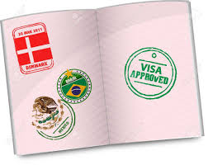
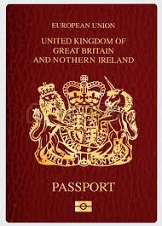
Factors influencing global travel and tourism
Trade and taxes
Some countries have a departure tax for when people leave the country. E.g. the UK has a charge known as Air Passenger Duty (APD) which is added to the cost of flights for those with more than 20 seats.
Legislation and Regulations
This can affect visitors in number of ways. Certain laws are put in place to try to ensure visitor safety and security or to protect the destination.
Political Factors
Political instability
The threat or outbreak of war can have a huge impact on tourism. Holidays may be cancelled and tourists will be advised not to travel.
Passport and visa entry requirements
To travel from the UK a tourist needs a valid passport in order to leave and gain entry to outbound destinations. Some countries also require a valid visa.
Funding and tax incentives
Tourism can benefit a country in many ways, so governments are keen to develop tourism in any way that they can e.g. in Kenya, the government has introduced tax incentives such as removing VAT from air tickets and park entrance fees to encourage more people to visit.

Slide 16
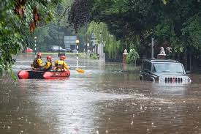
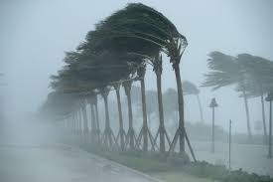
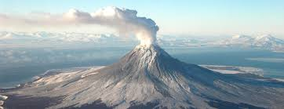
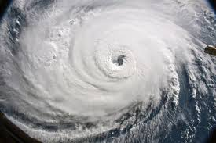
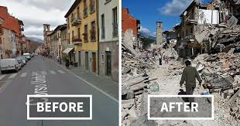
Factors influencing global travel and tourism
Geological hazards
e.g. Earthquake, Volcano
Can cause damage to infrastructure that is important to the travel and tourism industry- hotels, airport, roads etc.
Natural Disasters
Severe weather events- weather hazards
Can affect certain parts of the world on a regular basis.
Flooding
Drought
Fires
Landslides
Tornados
Avalanches
snowstorms

Slide 17
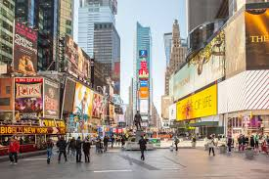



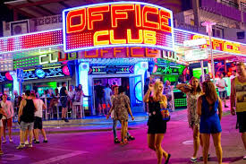
Factors influencing global travel and tourism
Types of media
Social media
Newspaper
Adverts
TV/News reports
Radio
TV Programmes
Visitor numbers
Locations used in TV shows and films become popular with tourists.
Media, publicity and image
Negative effects
Some destinations have been given bad reputations due to media coverage, which can affect the amount of people visiting that destination.
e.g. Magaluf is know as a ‘wild party’ resort.
Positive effects
Coverage of special events can show the good things about a resort and can generate a lot of positive publicity.
e.g. The World Cup in 2018 and the 2012 Summer Olympics in London

Slide 18
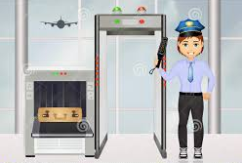

Factors influencing global travel and tourism
Safety measures
In order to keep tourists safe on holiday, authorities and travel providers will use a range of safety measures. Designed to stop problems arising and to provide visual reassurance that they take security seriously.
Airport safety
Airports have the most stringent safety measures of any organisation in the travel and tourism sector.
Luggage being screened
Individuals being screened
Passport checks
Can be time consuming and cause delays.
Safety and security
concerns
Personal Safety
Staying safe makes the difference between a dream holiday and a nightmare experience.
Being in an unfamiliar place and sometimes with a language barrier can put people at risk.
Theft of personal belongings
Getting lost
Accidents
Effects on tourism
If a destination is no longer considered as ‘safe’ then this can have a devastating impact on their tourism industry.
Safety guidance
Foreign and Commonwealth Office (FCO) will issue advice on safety and security to tourists. They will advise which countries are not safe to travel to and how to stay safe in certain destinations.

Slide 19
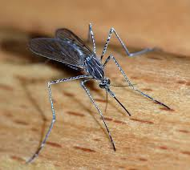
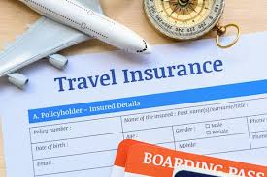
Factors influencing global travel and tourism
Effects on the destination
People may be reluctant to take the necessary precautions before they travel, this could be due to cost of vaccines or the time required. Therefore they may opt to travel to destinations that don’t require these things.
Infectious diseases and illnesses
These can affect tourists and the symptoms can be extremely unpleasant, sometimes resulting in death if not treated properly.
Malaria
Cholera
Tetanus
Norovirus
Yellow Fever
Health risks and precautions
Travel insurance
It is important for tourists to have insurance cover so…
Medical bills can be paid
If they get ill then they can claim money back against the cost of their holiday.
Insurance can help get them home if they are very ill or in the case of death.
Precautions and preventative measures
There are many common sense approaches that tourists can take to limit the possible risks.
Wearing insect repellent
Keeping exposed parts of the body covered
Using special bed netting
Having a required vaccine
Washing hands before eating
Drinking bottled water not tap water

Slide 20

Adapting and developing new products and services
The success of products and services depends on there being a demand from customers. This is in response to real-world situations.
e.g. 2015 terrorist attacks in Tunisia
TUI offered cut-price deals to encourage the recovery of Tunisian tourism.
Reviewing destinations offered
Organisations will constantly review destinations that they offer and add new destinations when needed, especially when they destinations have received positive media coverage and have become popular.
Travel and tourism organisations’
responses to factors
Adapting operational procedures
Organisations must review their procedures due to multiple global threats to security. This allows them to identify where they could improve their current practice, ensuring the safety and security of their customers.
Positive media coverage can lead to increased visitor numbers in destinations. Organisations may have to adapt by offering more flights to a destination e.g. in 2018, 70 new flights were being offered to Croatia.
When there is a natural disaster, travel organisations will adapt by cancelling flights.
Reviewing pricing structures
Many organisations perform a cost risk analysis and adjust prices in order to maintain visitor numbers. People are willing to travel to places that may considered ‘risky’ if they feel that the holiday price is excellent value for money.

Slide 21


Providing the public with up to date information
Travel advice is provided by local, regional and national government agencies.
Traffic reports and delays
Weather warnings affecting travel
Encouraging employment
Governments will provide funding to invest in tourism within their country. This helps to create jobs.
e.g. in 2015 the UK government pledged £1.7million of funding to provide 500 new apprenticeships and 1500 jobs.
Government
responses to factors
Travel restrictions
Governments have the power to impose travel restrictions. They can also limit the ability of members of their own population to travel freely. They can also restrict inbound tourist access to their country or part of it, along with visa restrictions.
Promoting a positive image
It is important to promote a positive image that encourages tourism. Governments have organisations that are responsible for tourism promotion. E.g. in the UK we have VisitBritain.
Introducing security measures
Governments constantly review their security measures due to the ongoing threat of terrorism.
e.g. venues now have to check all bags before members of the public are allowed to enter.

Slide 22


Voluntary organisations play an important role in global travel and tourism…
Preserve historic buildings
Promote sustainable tourism
Provide emergency support to destinations affected by major events.
Voluntary organisations’
responses to factors
Raising funds
Securing funding is an important issue for tourism charities that want to promote sustainable tourism.
Raising awareness of issues
Work with governments to raise the negative issues associated with global tourism. Voluntary organisations (charities) believe that if tourism isn’t managed then this will have a negative impact on local communities and environments and can cause long-term problems for residents, including the overall decline of tourism.

Slide 23
Learning Aim B
Impact of travel and tourism and sustainability

Slide 24

Impacts of tourism
People living in destinations are that are more reliant on income from tourism for their livelihood are more at risk from exploitation. Social impacts affect people and their lives.
Negative impacts
Disruption to everyday life
Loss of culture
Resentment towards visitors
Increased crime
Exploitation of locals
Social impacts
Positive impacts
Improved quality of life
Access to facilities
Improved transport and infrastructure
Improved cultural awareness

Slide 25
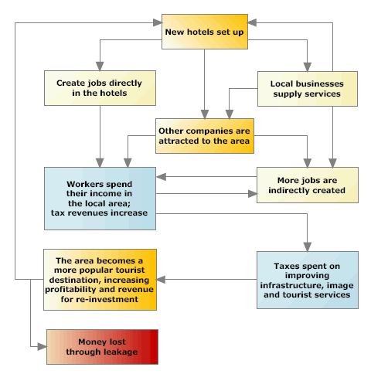
Impacts of tourism
Tourism can bring economic benefits to an area. However, often local communities do not receive a fair share of the overall income generated by tourism. Too much money can go to the big organisations and not to the people or local organisations who are in direct contact with tourists.
Economic impacts
Negative impacts
Low-paid jobs
Seasonal unemployment
Increased cost of living
Positive impacts
Economic multiplier effect
Employment opportunities
Training and education
Foreign currency earnings

Slide 26

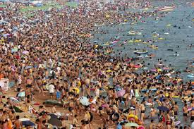
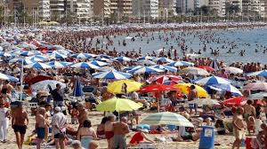
Impacts of tourism
One of the biggest global issues is how we care for the environment. People are worried that tourism currently places too much pressure on the environment and irreversible harm is being done, such as affects on wildlife.
Environmental
impacts
Positive impacts
Conservation
Education
Open spaces and improved street furniture
Regeneration
Negative impacts
Increased pollution
Overcrowding
Traffic congestion
Reduced biodiversity
Erosion

Slide 27


Managing social impacts
How to show respect for traditions and religions
Tourists are welcomed to get involved in local traditions and religions, it is often seen as great respect.
It can also enhance the experience of the holiday for tourists and educate them about different cultures.
How to behave and dress appropriately
Many destinations have different cultural practices to our own and have rules about…
How to behave in public
Not openly kissing in public
Dressing modestly
Reducing negative impacts of behaviour
When on holiday people like to ‘let their hair down’, this sometimes involves ‘excessive’ behaviour such as drinking too much alcohol. In some places, British tourists, especially young adults have a poor reputation and can have a negative impact on a destination.
Rowdy behaviour and noise pollution
Not respecting local dress codes
Local services like ambulances having to spend time dealing with drunk tourists.
One solution has been to have British police walking the streets of Magaluf and Ibiza to act as a deterrent to those who want to break the law.
How to avoid conflict
Follow rules for photography
Learn basic cultural mannerisms e.g. tipping etiquette
Respect local culture and religion
Make an effort to fit in

Slide 28


How infrastructure development can benefit local people
Transport
Improving roads, trams, airports and railways benefits locals and tourists.
Local people can get to work more quickly and easily.
Good transport will attract more visitors.
Telecommunications networks
When people go on holiday they like to share pictures of their experiences. Having a good Wi-Fi connection can help local people to access products, jobs, trade etc.
Water and sewerage systems
Power supply
Buildings
Benefits of Partnership projects
Having the support of the local community is essential for any business to succeed. Without the support of locals, conflict could quickly arise.
Increase in profits and money earned from tourism
Jobs created
Improved visitor experience
Alternative source of income for local people
Less risk to the environment- conservation

Slide 29
Learning Aim C
Destination Management

Slide 30
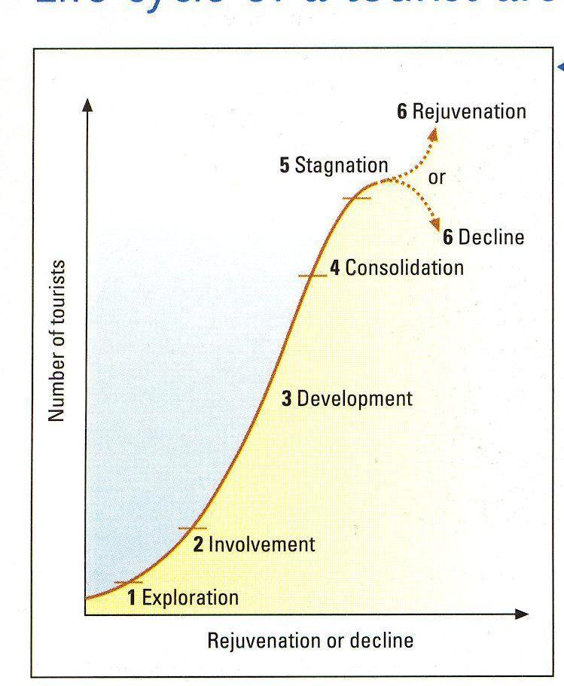
Tourism Development
Butler’s Tourism Area Life Cycle (TALC) Model
Exploration
Tourism is very small scale and low key.
When small numbers of people visit an area because of something unique like an amazing feature such as a beach.
Involvement
When the local population begins to respond to the needs of visitors by introducing local amenities such as hotels and restaurants etc.
Development
When tour operators notice the potential of an area for tourism. The number of visitors begins to rise. Locations are promoted as a tourist destination.
Consolidation
When tourism becomes part of the area. Local people are employed in the industry, visitor numbers grow steadily. Older amenities may become dated and untidy. Some destinations risk becoming unattractive to visitors and unpopular.
Stagnation
The number of visitors starts to drop, often due to a negative image of the destination. Leads to a loss of business for local people, some may have to close.
Decline or Rejuvenation
Decline is causes by visitor numbers dropping dramatically. Those who do visit only do so because it is cheap. Smaller hotels close. Area becomes run down.
Rejuvenation is an investment to ‘smarten’ up local features and re-invent the destination to try to attract visitors again.

Slide 31
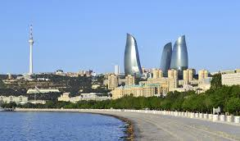
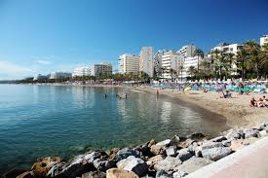
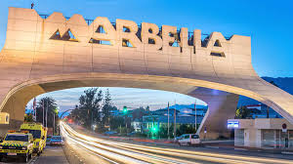
Emerging Destinations
Mature Destinations
These are locations that have grown in popularity over the last ten years and have seen a growth rate of visitor arrivals of over 4% year on year.
Offer a different kind of holiday experience.
These destinations have been popular for well over 20 years and have seen tourism develop and grow over this time.
Characteristics
Visitors that seek adventure
Difficult to access from overseas
Underdeveloped transport links
Basic infrastructure
Access to basic healthcare and education
Unspoilt natural and cultural features
Traditional lifestyles
Low volumes of visitors
E.g. Baku, Azerbaijan
Characteristics
Mass tourism
Good transport links
Developed infrastructure
Established tourist season
Reliance on tourism as a main source of income
Well advertised and marketed
Conflict between the local community and tourists
E.g. Marbella, Costa del Sol, Spain

Slide 32


Partnerships
Partnerships are essential for travel and tourism organisations.
Effective partnerships can help an organisation gain an advantage over others through sharing costs and working together on projects and ideas.
Public-Private sector partnerships- PPP’s
Advantages
Shared resources, skills and expertise
New ideas
Shared costs
Increased publicity
Disadvantages
Conflicting aims and priorities
Less flexibility
Slows down decision making
Difficulty in responding to change

Slide 33



Destination Management Organisations- DMO’s
These are organisations that promote, manage and help to develop tourism in their area.
This can include working with a range of partners to promote different tourism activities, facilities and events within a local area.
UK National DMO – VisitBritain
UK Regional DMO – Visit Cheshire
UK Local DMO – Visit Liverpool
Benefits of DMO’s
Raising the profile of a destination
Launching new products
Marketing
Funding and sponsorship

