Slide 1
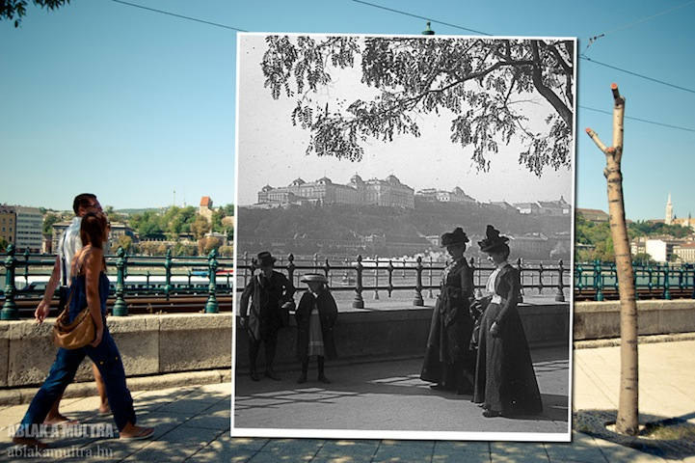
Why do we study History?
It is the window into the past.

Slide 2
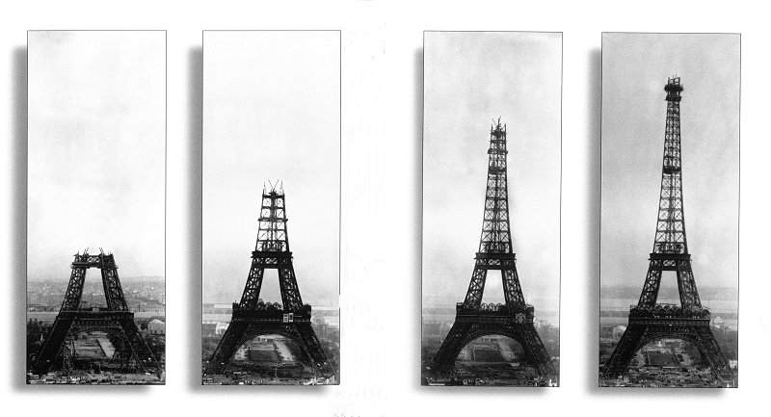
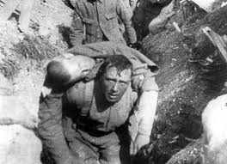
Why do we study History?
You can be inspired by acts of bravery and genius of our ancestors.

Slide 3
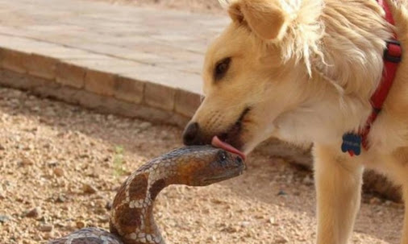
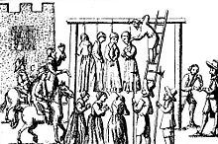
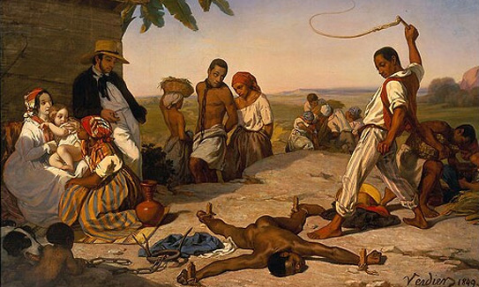
Why do we study History?
You can learn how people lived with and overcame hatred, fear and discrimination.

Slide 4
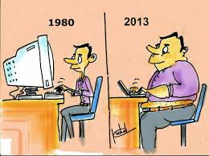
Why do we study History?
Understanding the past is the key to understanding the present.

Slide 5
Why do we study History?
It keeps us informed on current events as they unfold.

Slide 6
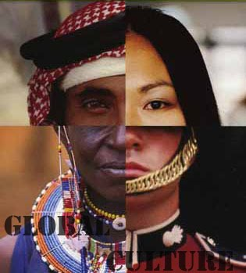
Why do we study History?
It helps us appreciate multiple perspectives and interpretations.

Slide 7
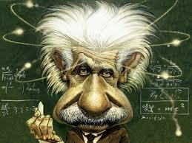
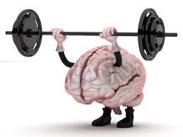
Why do we study History?
Analysing history strengthens our critical thinking skills.

Slide 8
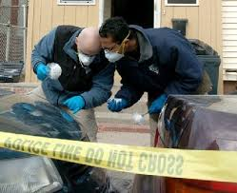
Why do we study History?
It trains us to gather evidence and to find patterns and trends.

Slide 9
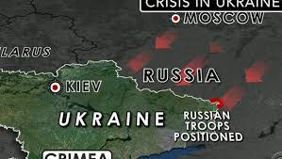
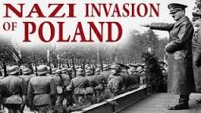
Why do we study History?
You can apply information from the past to analyse and solve problems in the present.

Slide 10
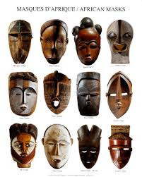
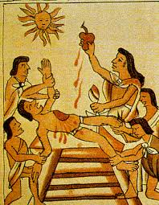
Why do we study History?
It gives us an understanding of other people and cultures.

Slide 11
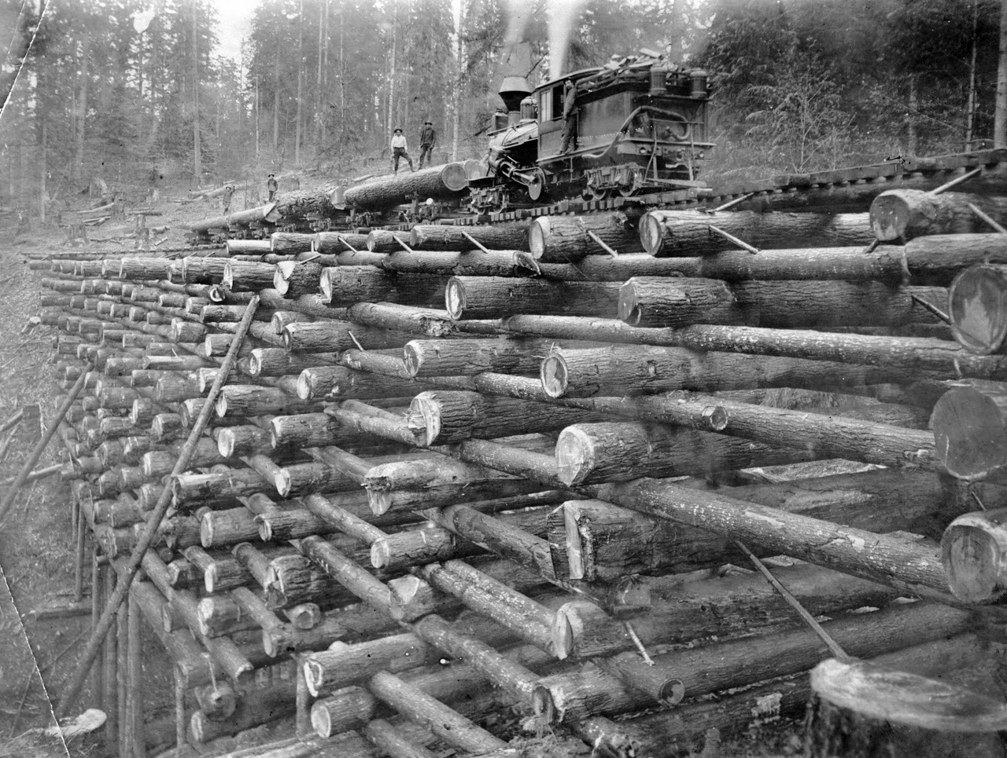
Why do we study History?
History challenges us to think outside the box and to be creative.

Slide 12
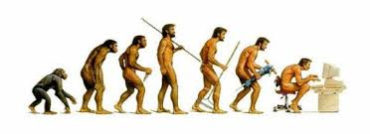
Why do we study History?
It’s fun!

Slide 13
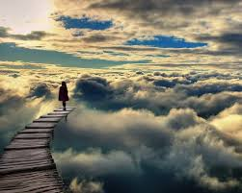
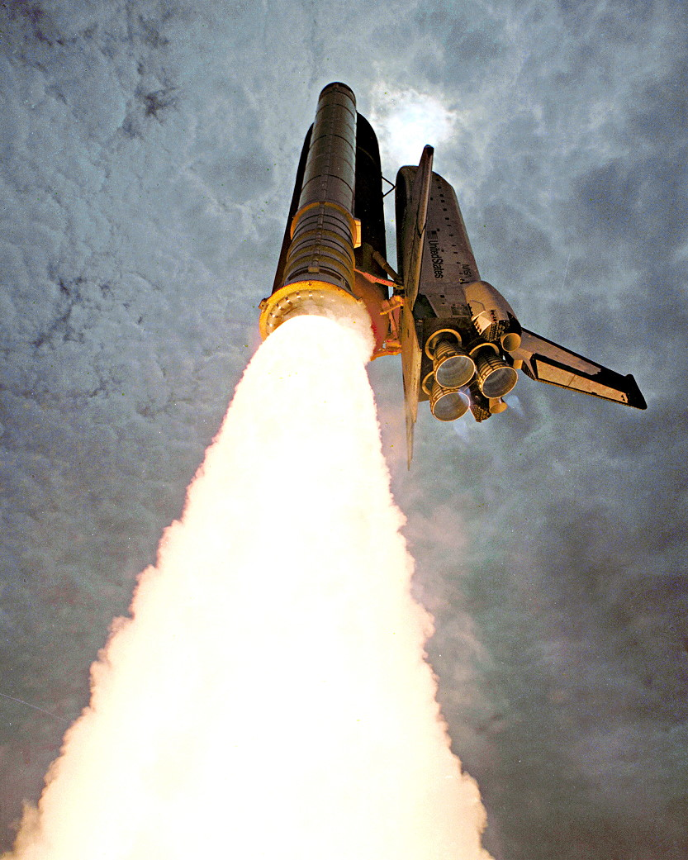
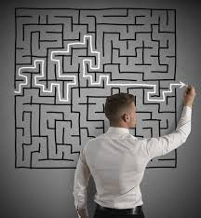
Why do we study History?
It gives us the excitement of discovery and the reward of solving real-world problems.

